Slide 1
Computer Architecture
Lectorial Week 4

Slide 2
Objectives
Looking at last week’s reinforcement exercises
Counter
Memory (RAM)
Looking forward
What is a program?
Combining parts we have made to automate a sequence of instructions

Slide 3
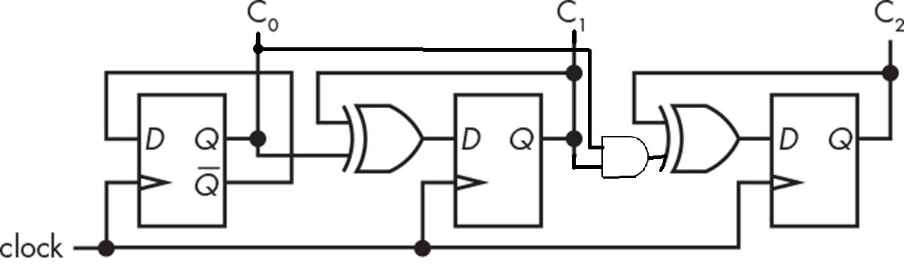

Week 3 Reinforcement Part 2
Create a 3-bit counter
Use Logisim built-in D flip-flop
Add ability to reset to zero and to set a specific value
Decimal | 4 | 2 | 1
0 | 0 | 0 | 0
1 | 0 | 0 | 1
2 | 0 | 1 | 0
3 | 0 | 1 | 1
4 | 1 | 0 | 0
5 | 1 | 0 | 1
6 | 1 | 1 | 0
7 | 1 | 1 | 1

Slide 4
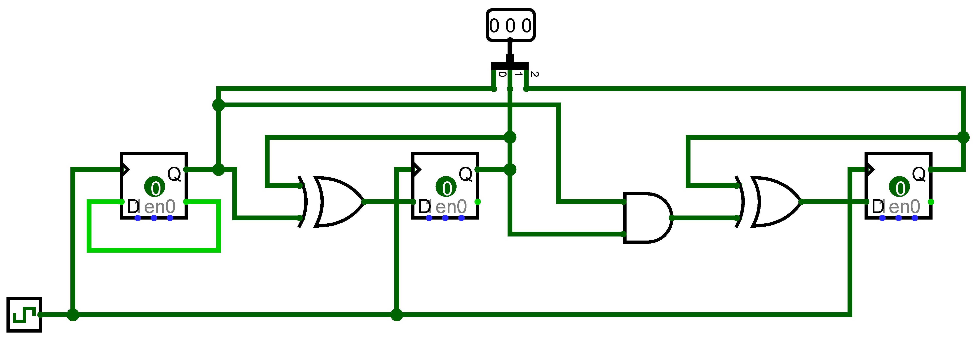
Week 3 Reinforcement Part 2
Create a counter using Logisim inbuilt flip-flops
Combining the outputs to an output pin

Slide 5
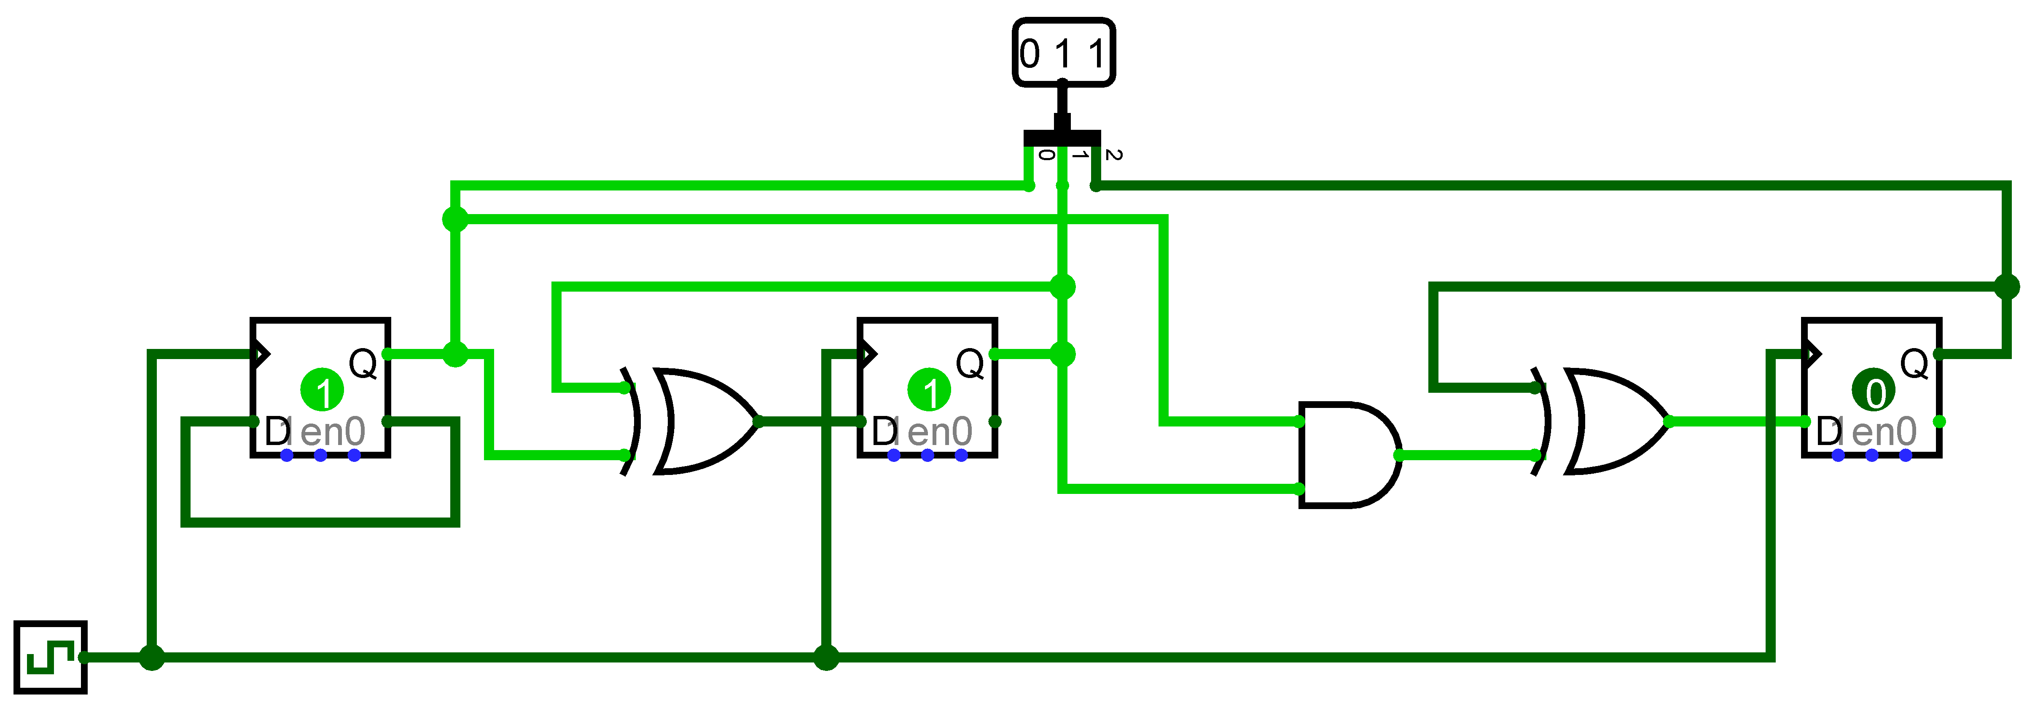
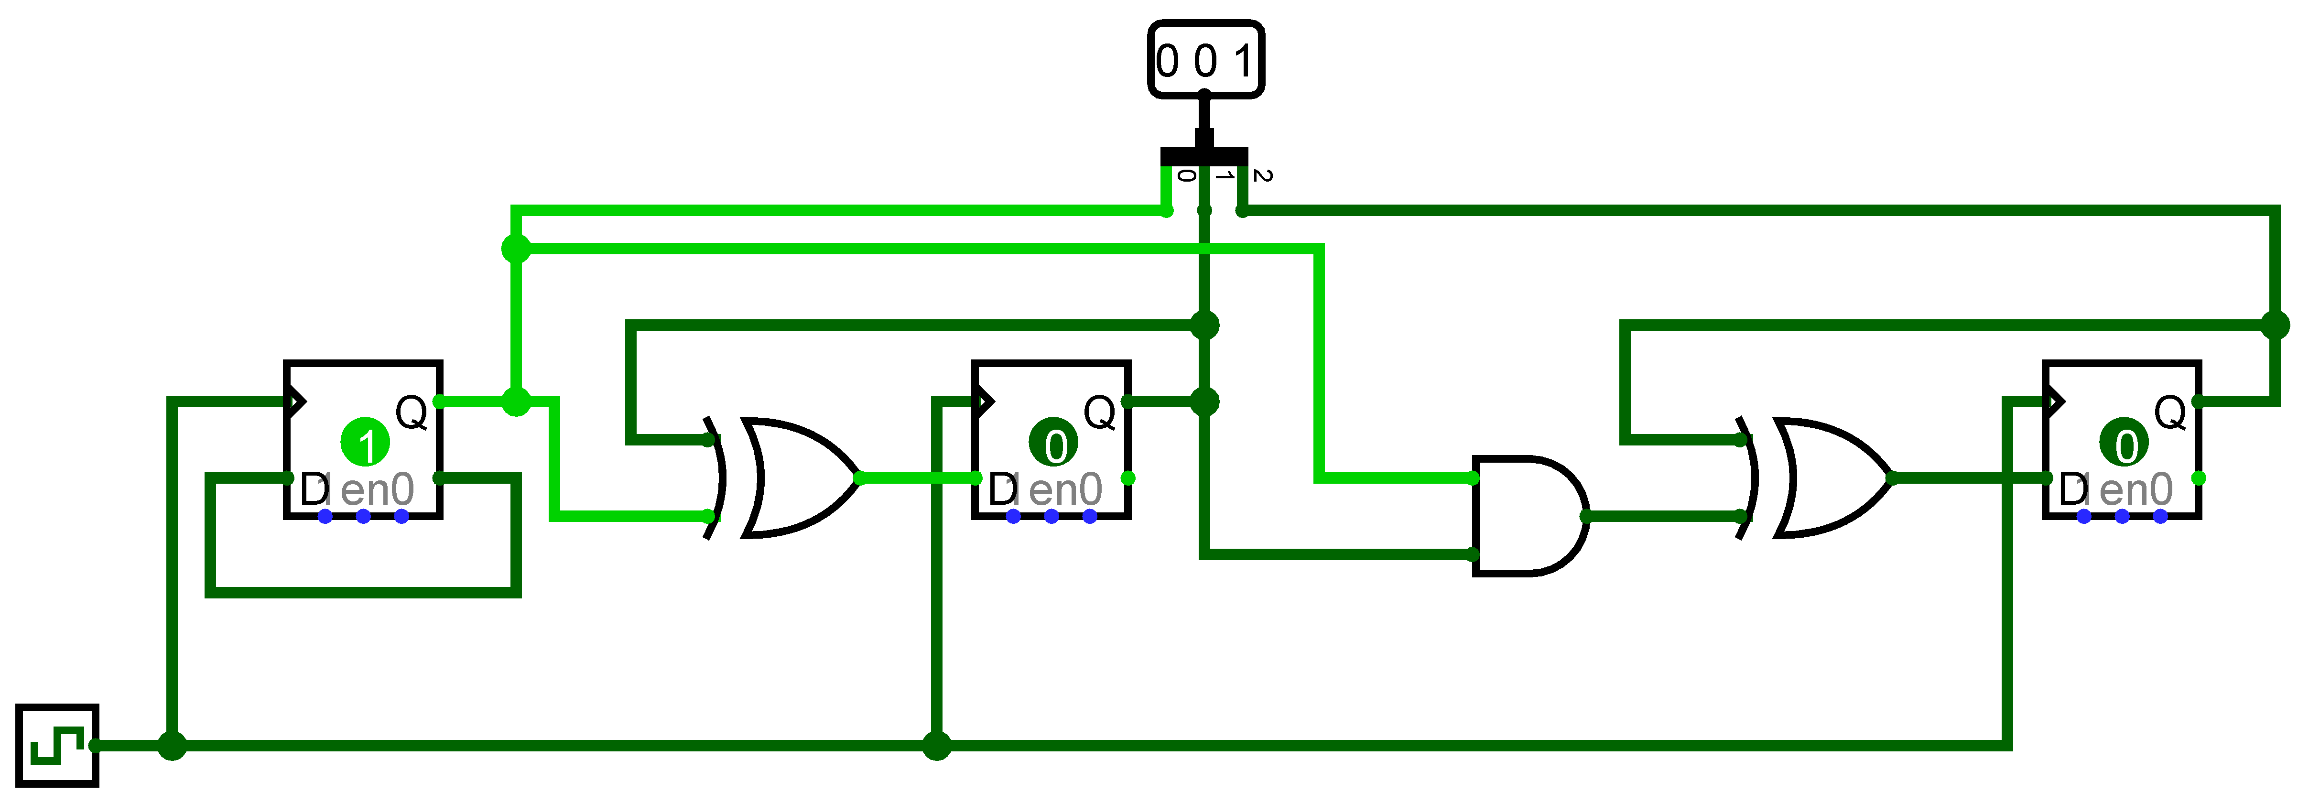
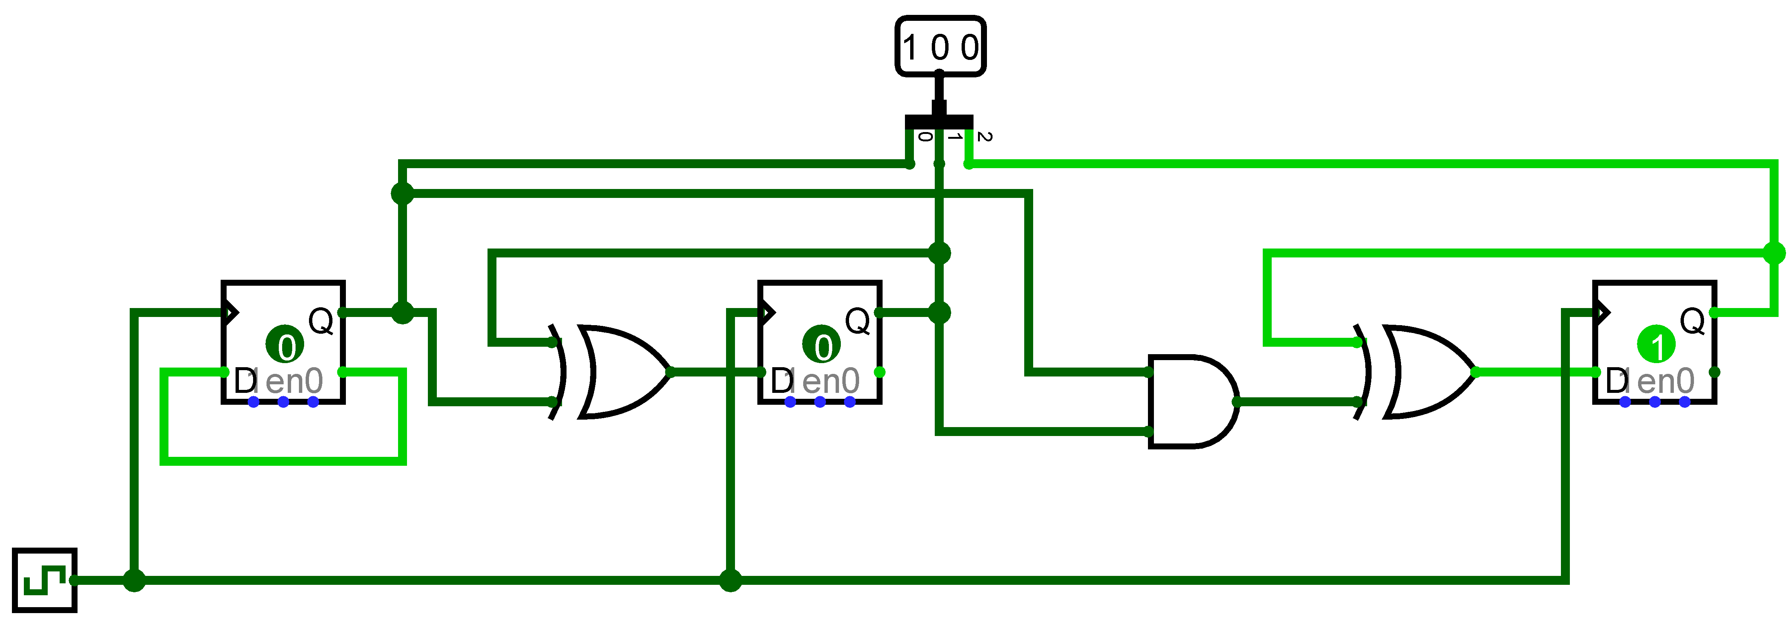
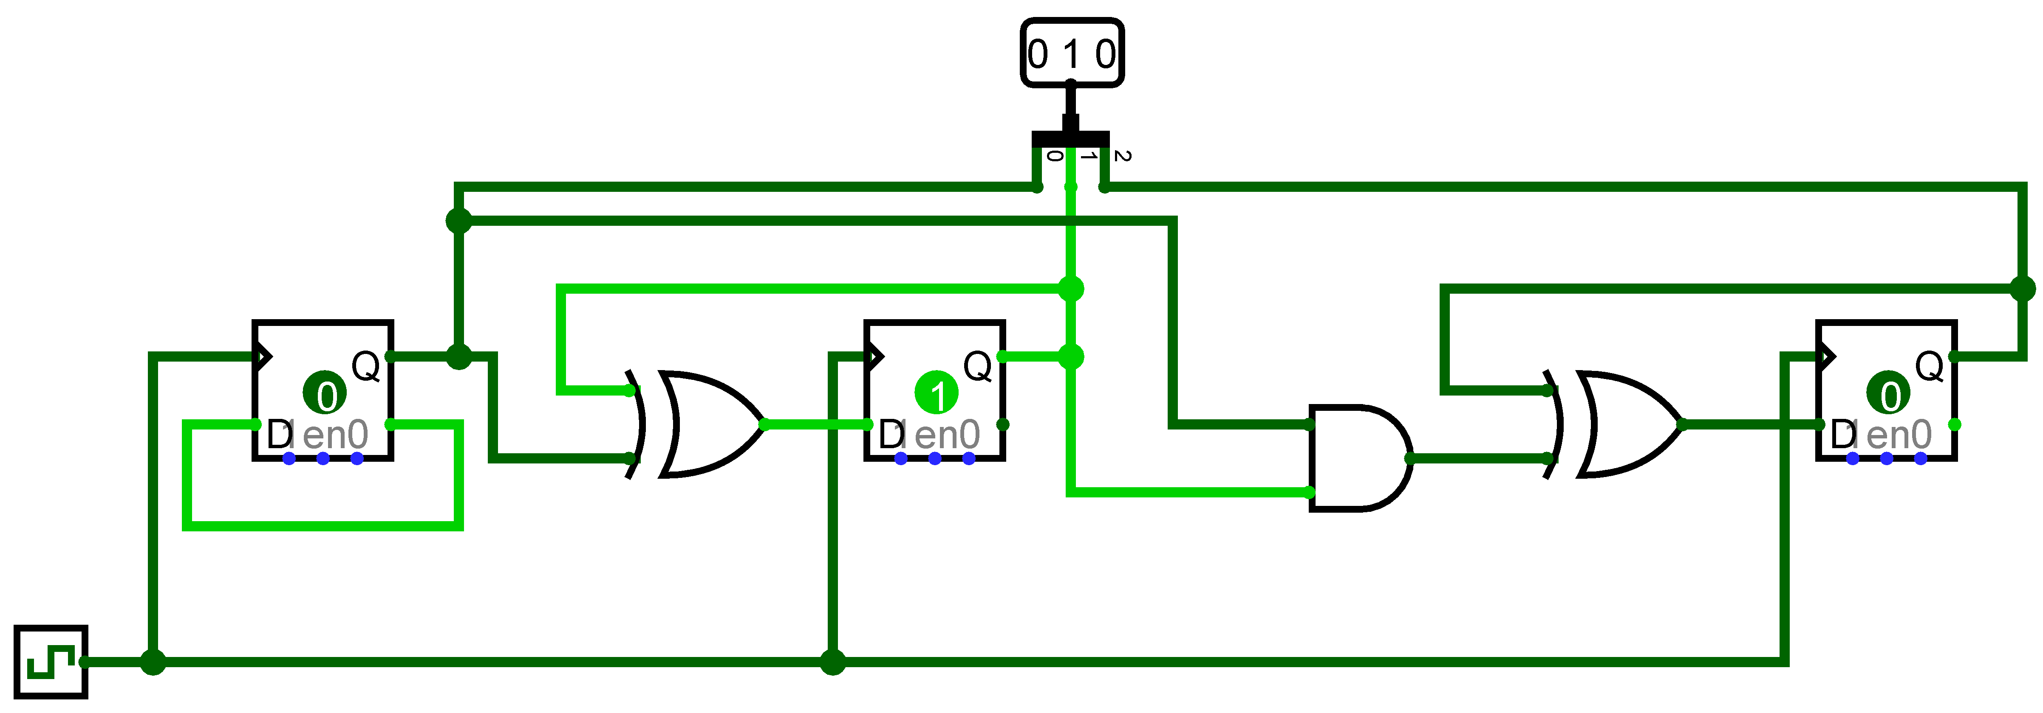
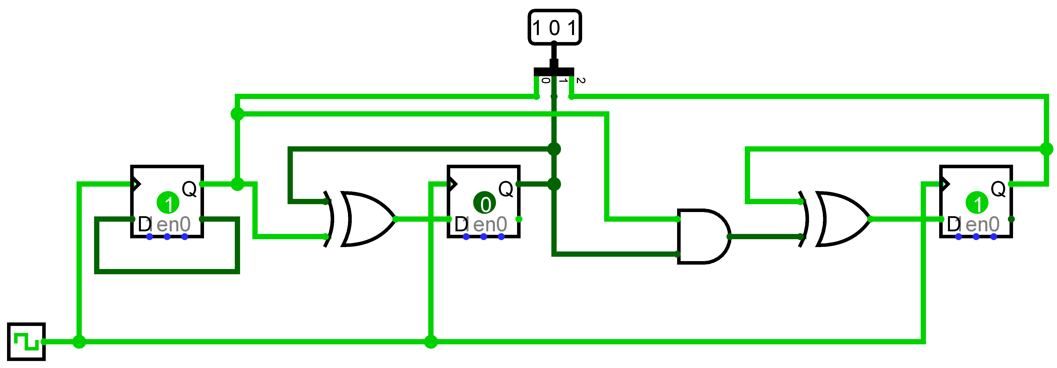
Counter
Clicking the clock to increment

Slide 6
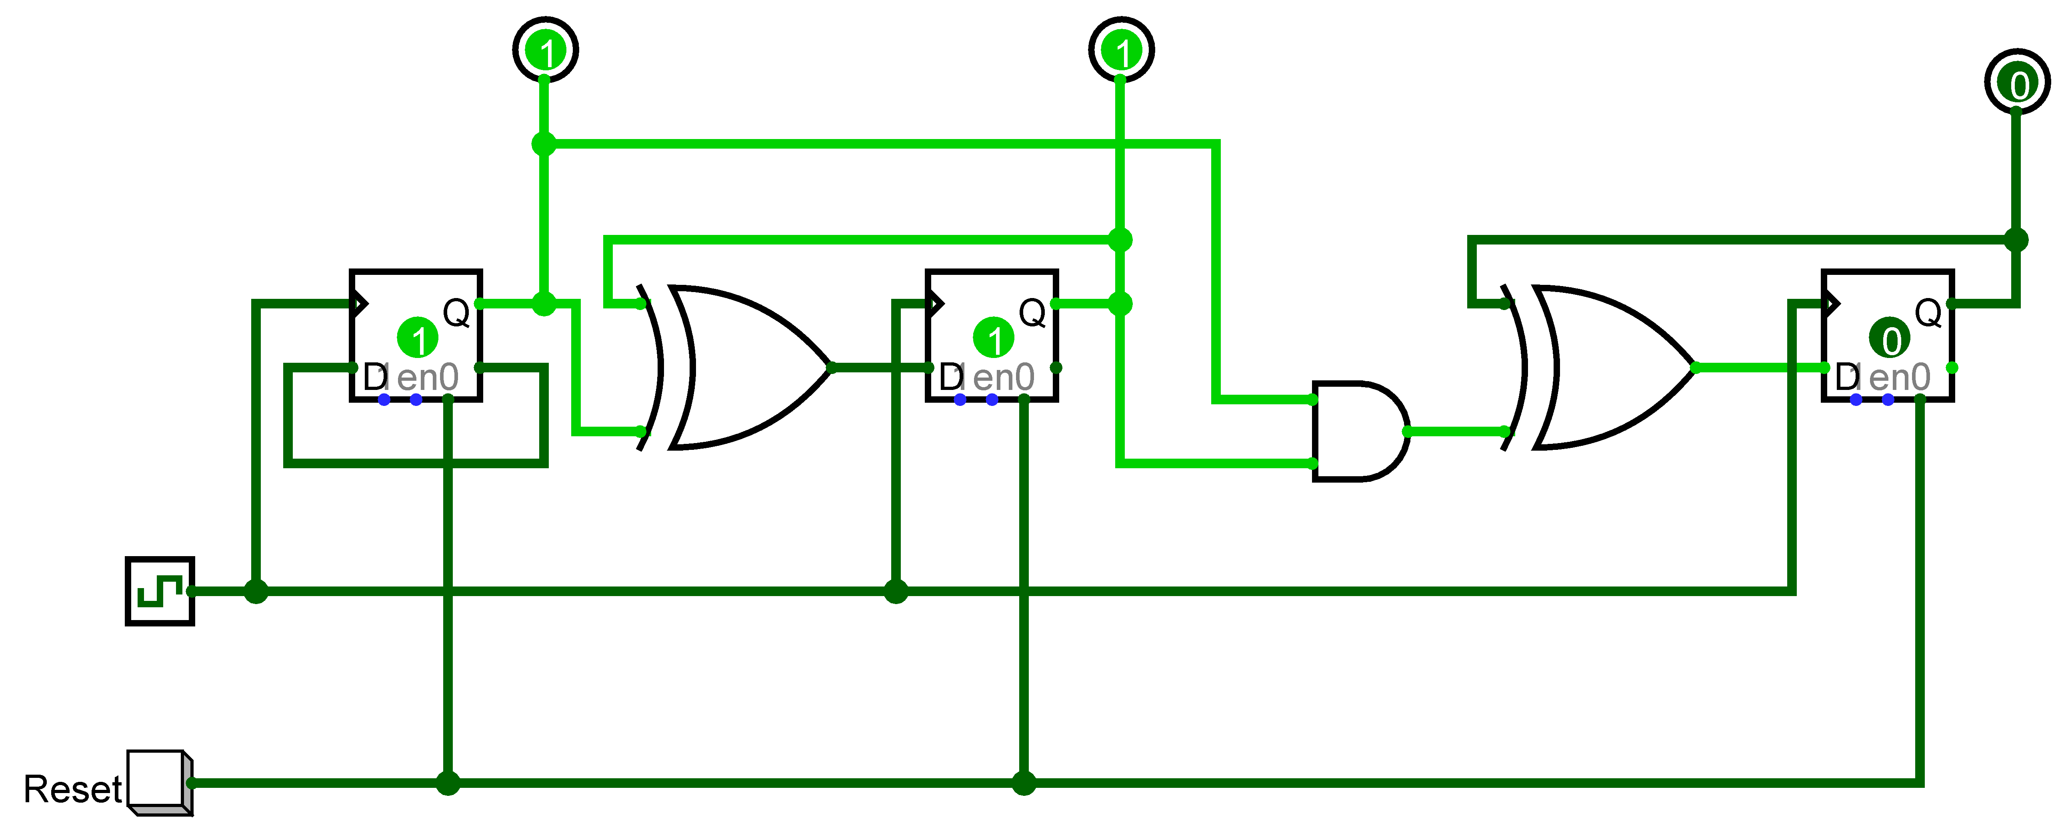
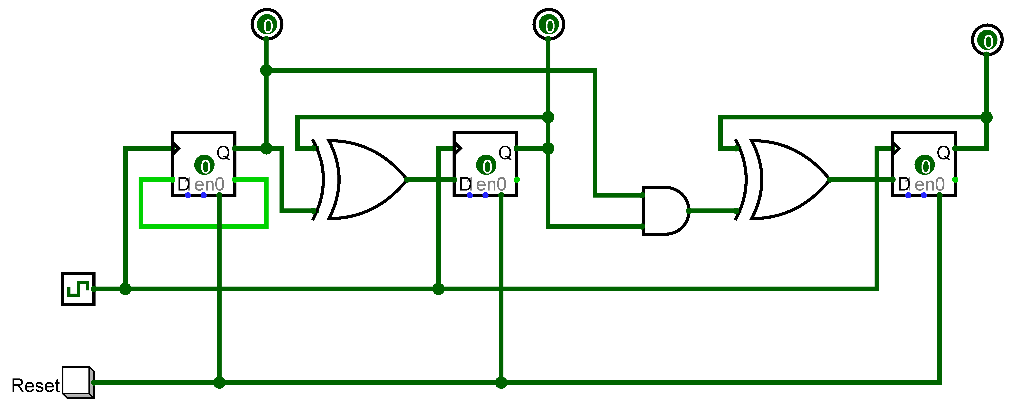
Counter with reset button
Before reset
After reset

Slide 7
Counter with set and reset
Want to set the counter to a specified value
Use a 3-bit input pin for the value and a 1-bit input to indicate that the value needs to be used
Need to use both the 1 and 0 inputs on the flip-flop
Want to set the 1 input to 1 when
Corresponding bit on input pin is 1
AND
Set button is pressed

Slide 8
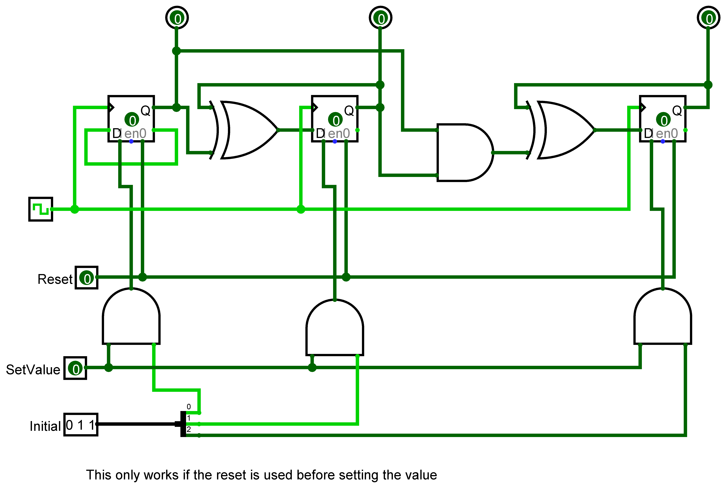
Counter with set and reset
Here you have to do reset before set

Slide 9
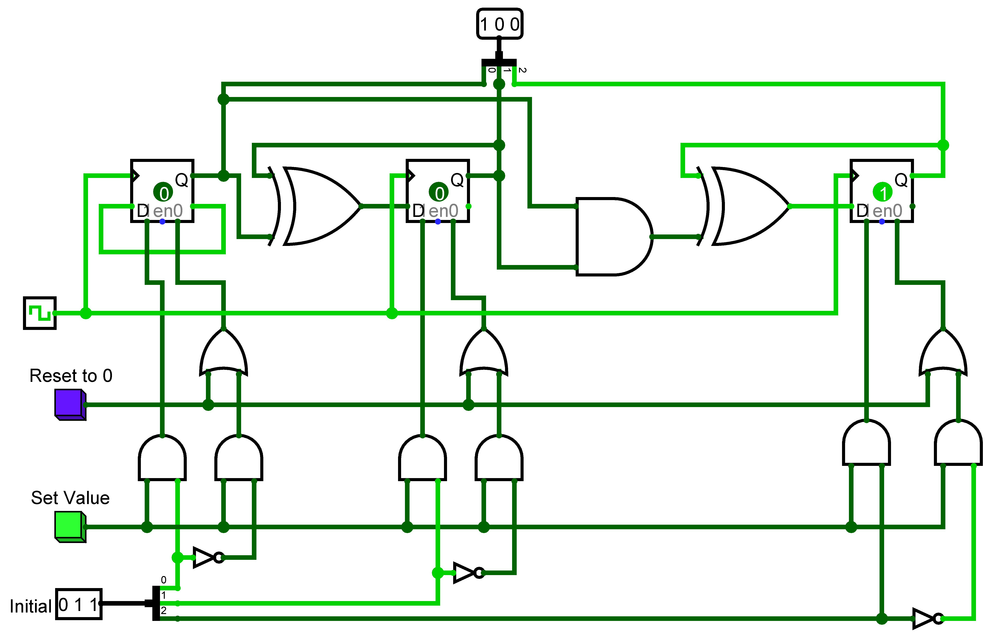
Counter with set and reset
Additional gates so that set works fully without pressing reset first

Slide 10
Week 3 Reinforcement Part 3
Addressable Memory
In the lab we looked at ROM
Set the values stored in four registers manually (4-bit data)
Used a multiplexer to select the data from a specific 2-bit address
Now we need to look at being able to update the data in the memory – RAM
Set the value in the register at a specific address from an input pin
Keep the part that selects the data from the required register
Investigating the Logisim built-in memory components

Slide 11
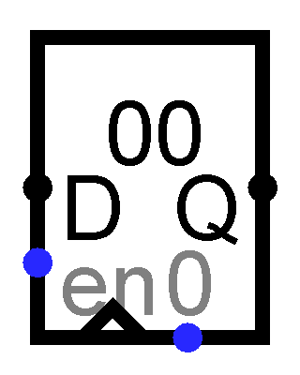
Creating RAM
How to store a value?
Have a 4-bit input
Can connect this to the data (D) input on the registers
Have to only update the register at the address given
Can set the enable input to 1 only for the register we want to update
Can use a decoder to decode the address and pass a signal of 1

Slide 12
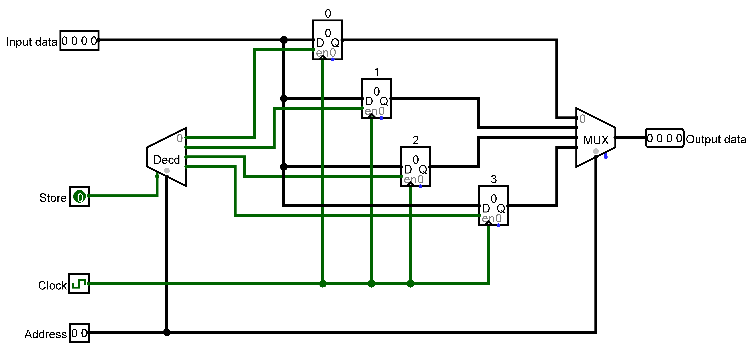
Creating RAM
4-bit input data
2-bit address
Four registers – each holds 4-bits
Addresses are 0 to 3 in decimal
Store signal for storing the input according to the address
4-bit output data

Slide 13
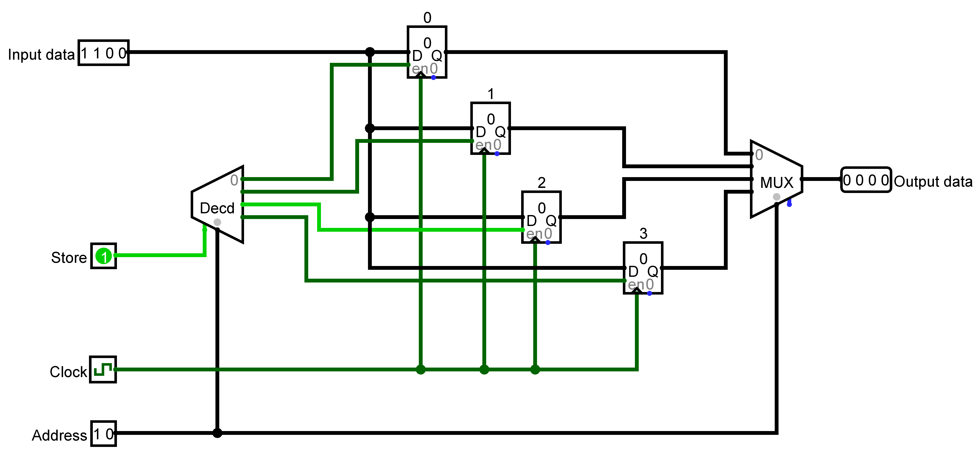
Storing a value in the RAM
I want to store decimal 12 (binary 1100, or hex c) in the register at address decimal 2 (binary 10)
Store is set to 1

Slide 14
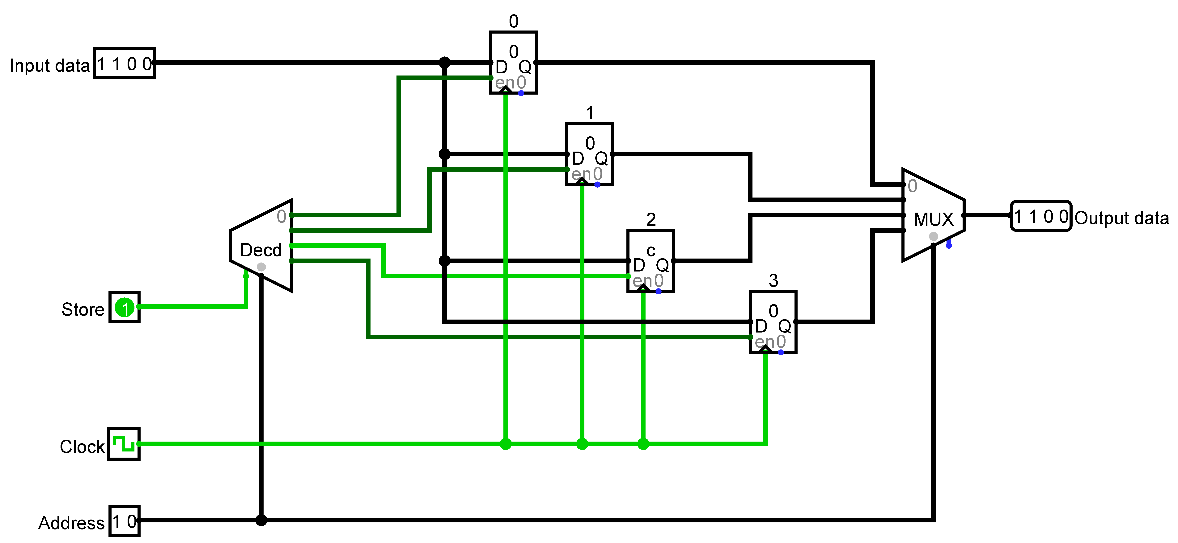
Storing a value in the RAM
After clock has changed from 0 to 1

Slide 15
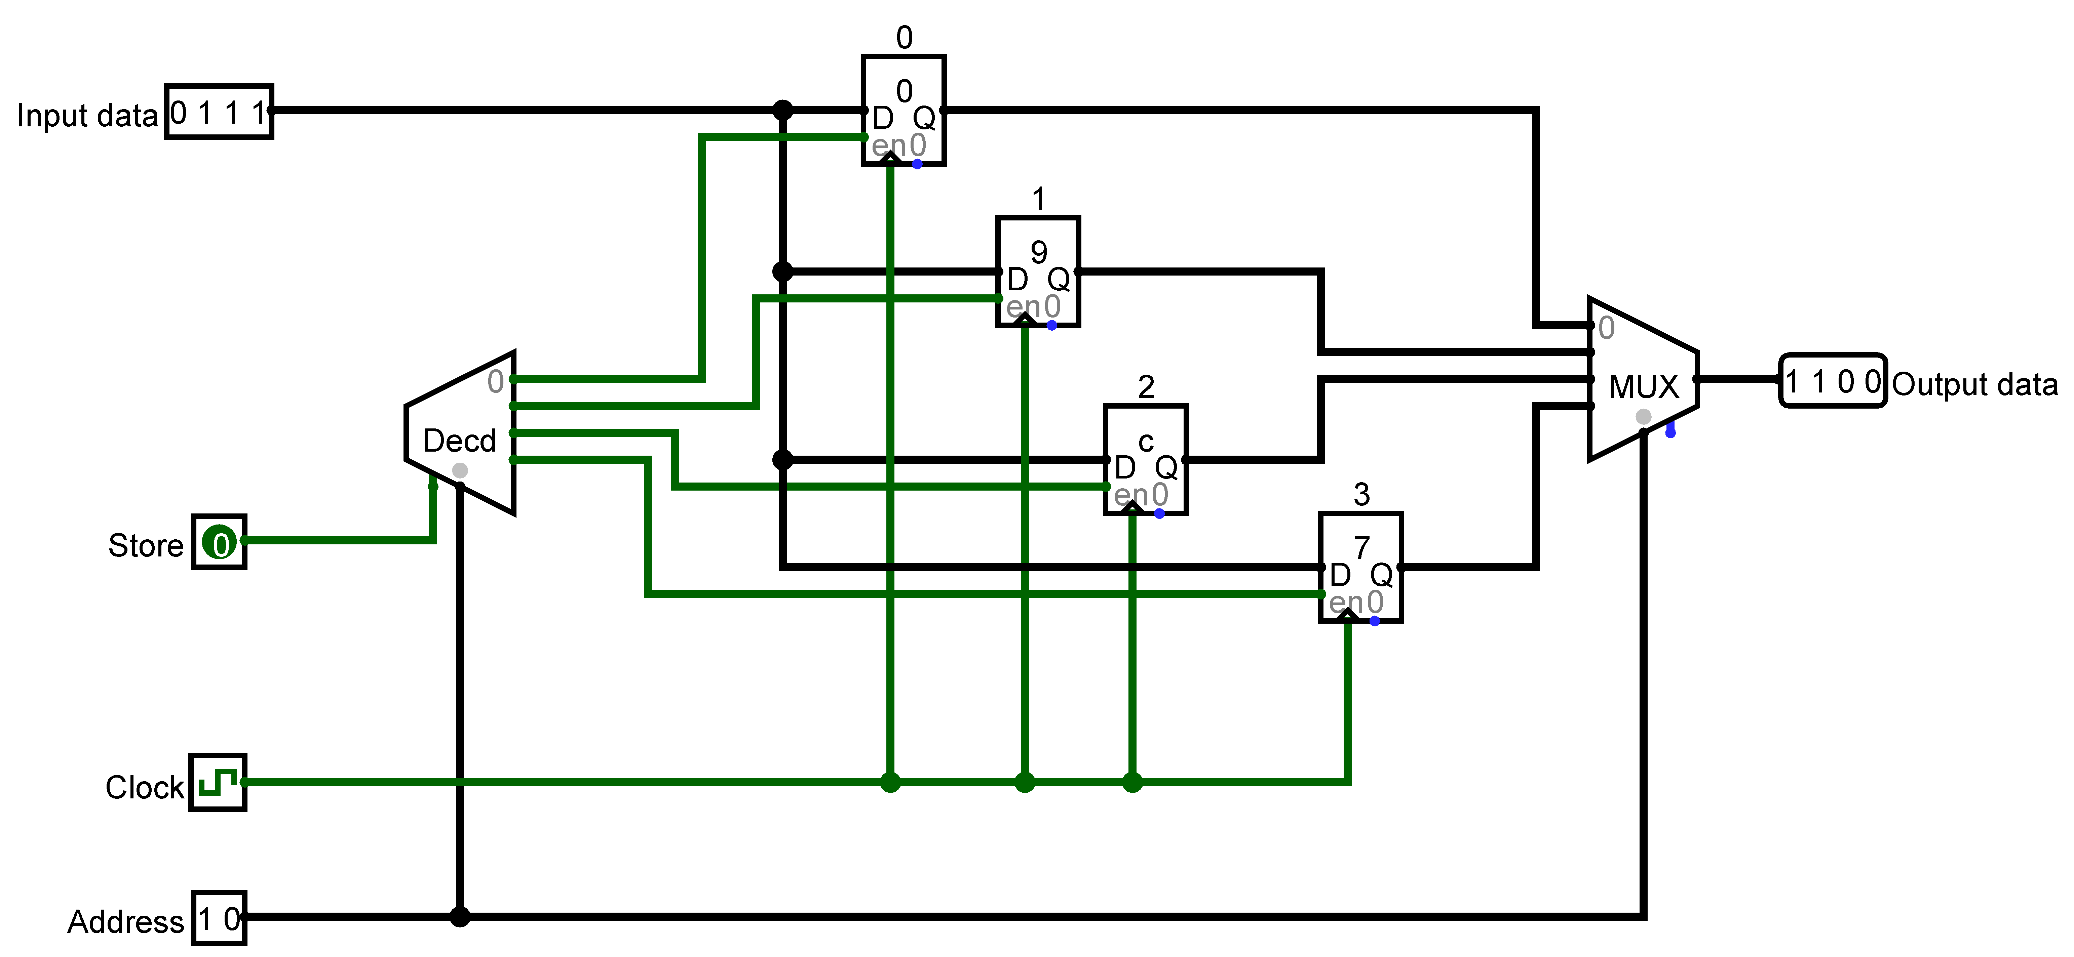
Storing a value in the RAM
I have the data stored in registers and want to read the value stored at register 2 (binary 10)

Slide 16
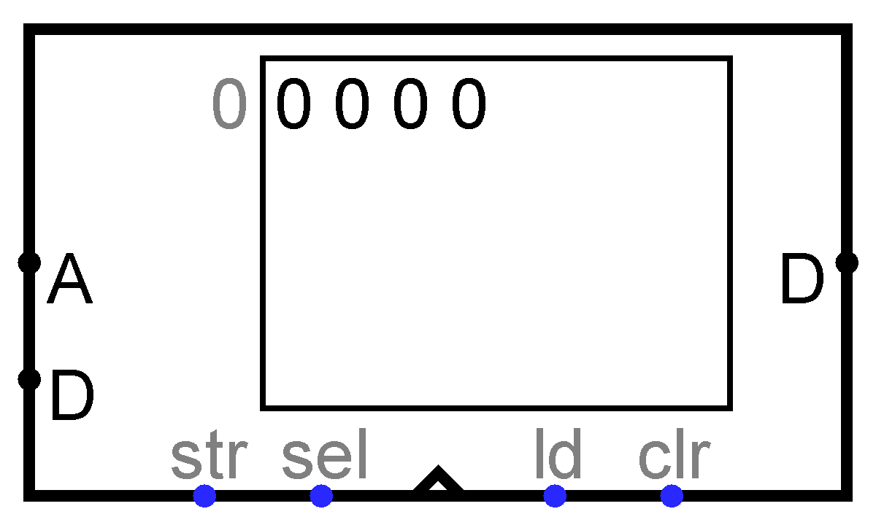
Looking at the Logisim RAM component
Logisim RAM with setting:
Separate load and store ports
To update the memory at an address
Set the store (str) input to 1
Set the address and data input
The memory will change when the clock changes from 0 to 1

Slide 17
Looking forward
We will connect components together to form an automated device
We have created
ALU
Two data inputs
Input to indicate the operation to carry out
Output the result of the operation
Registers
Counter
Memory
We will use Logisim built-in components for the registers, counter and memory

Slide 18
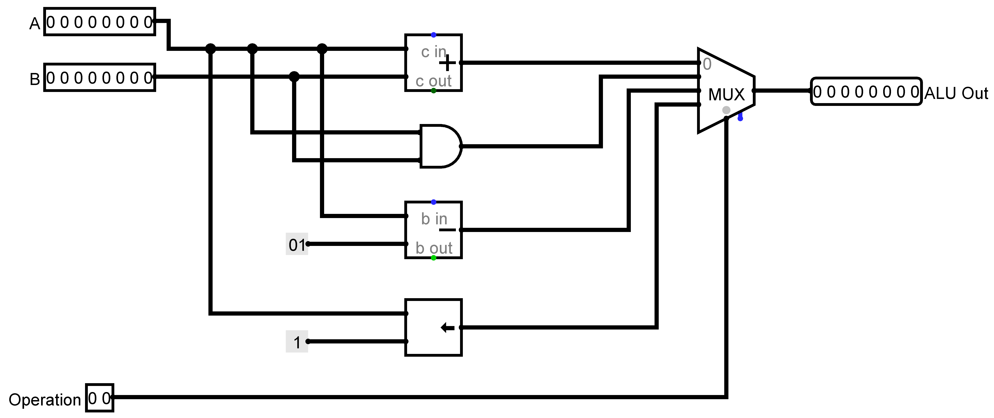
ALU – as created in week 2

Slide 19
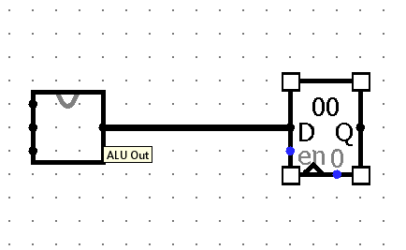
Using the ALU
Use the ALU as a sub-circuit
We can use a register for the output of the ALU

Slide 20
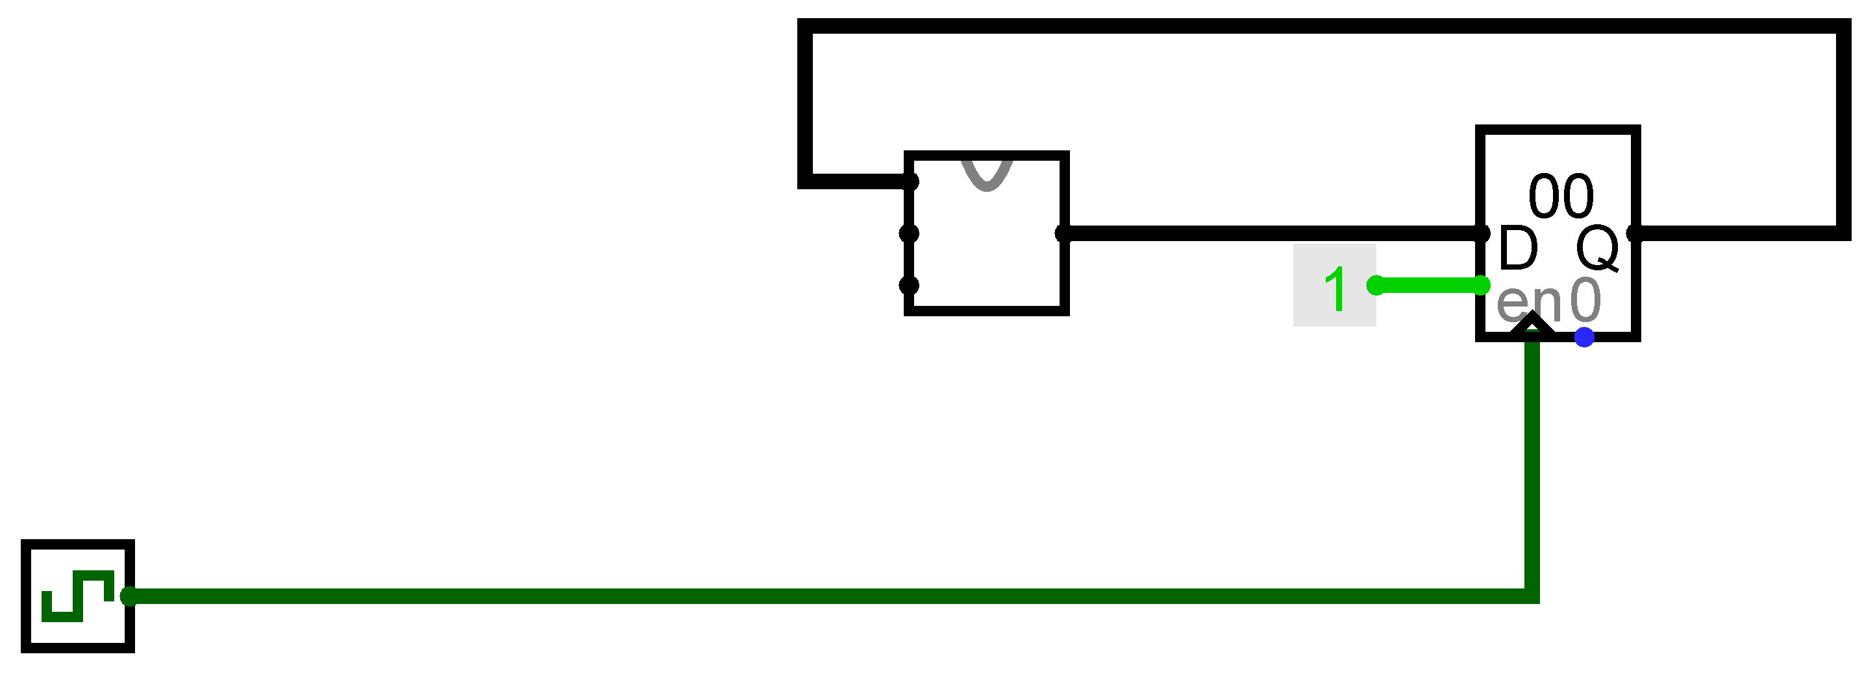
Using the ALU
Keeping a total
Connect the register containing the output of the ALU to one of its inputs for the next operation – this register is now an accumulator

Slide 21
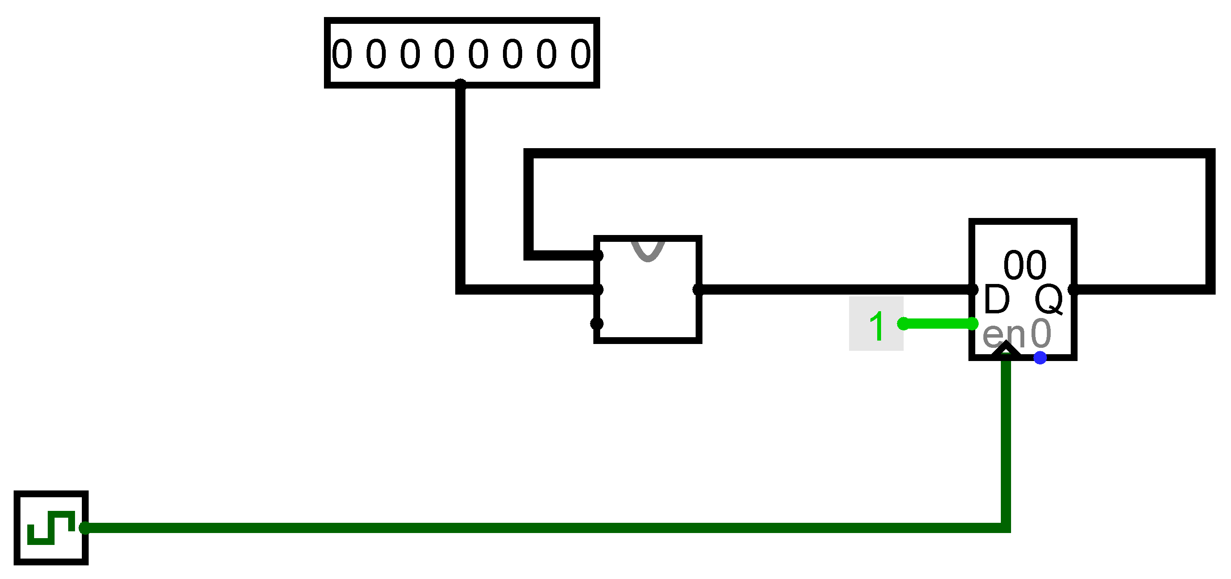
Using the ALU
For this demo we will use an input pin for the second input to the ALU

Slide 22
What is a program?
A program is a set of instructions
For this ALU an instruction is a number between 0 and 3 (2 bits)
We can use ROM to store the instructions
Each item in memory has an address
The number of items we can store depends on the number of bits in the address
We will use an address of 4 bits

Slide 23
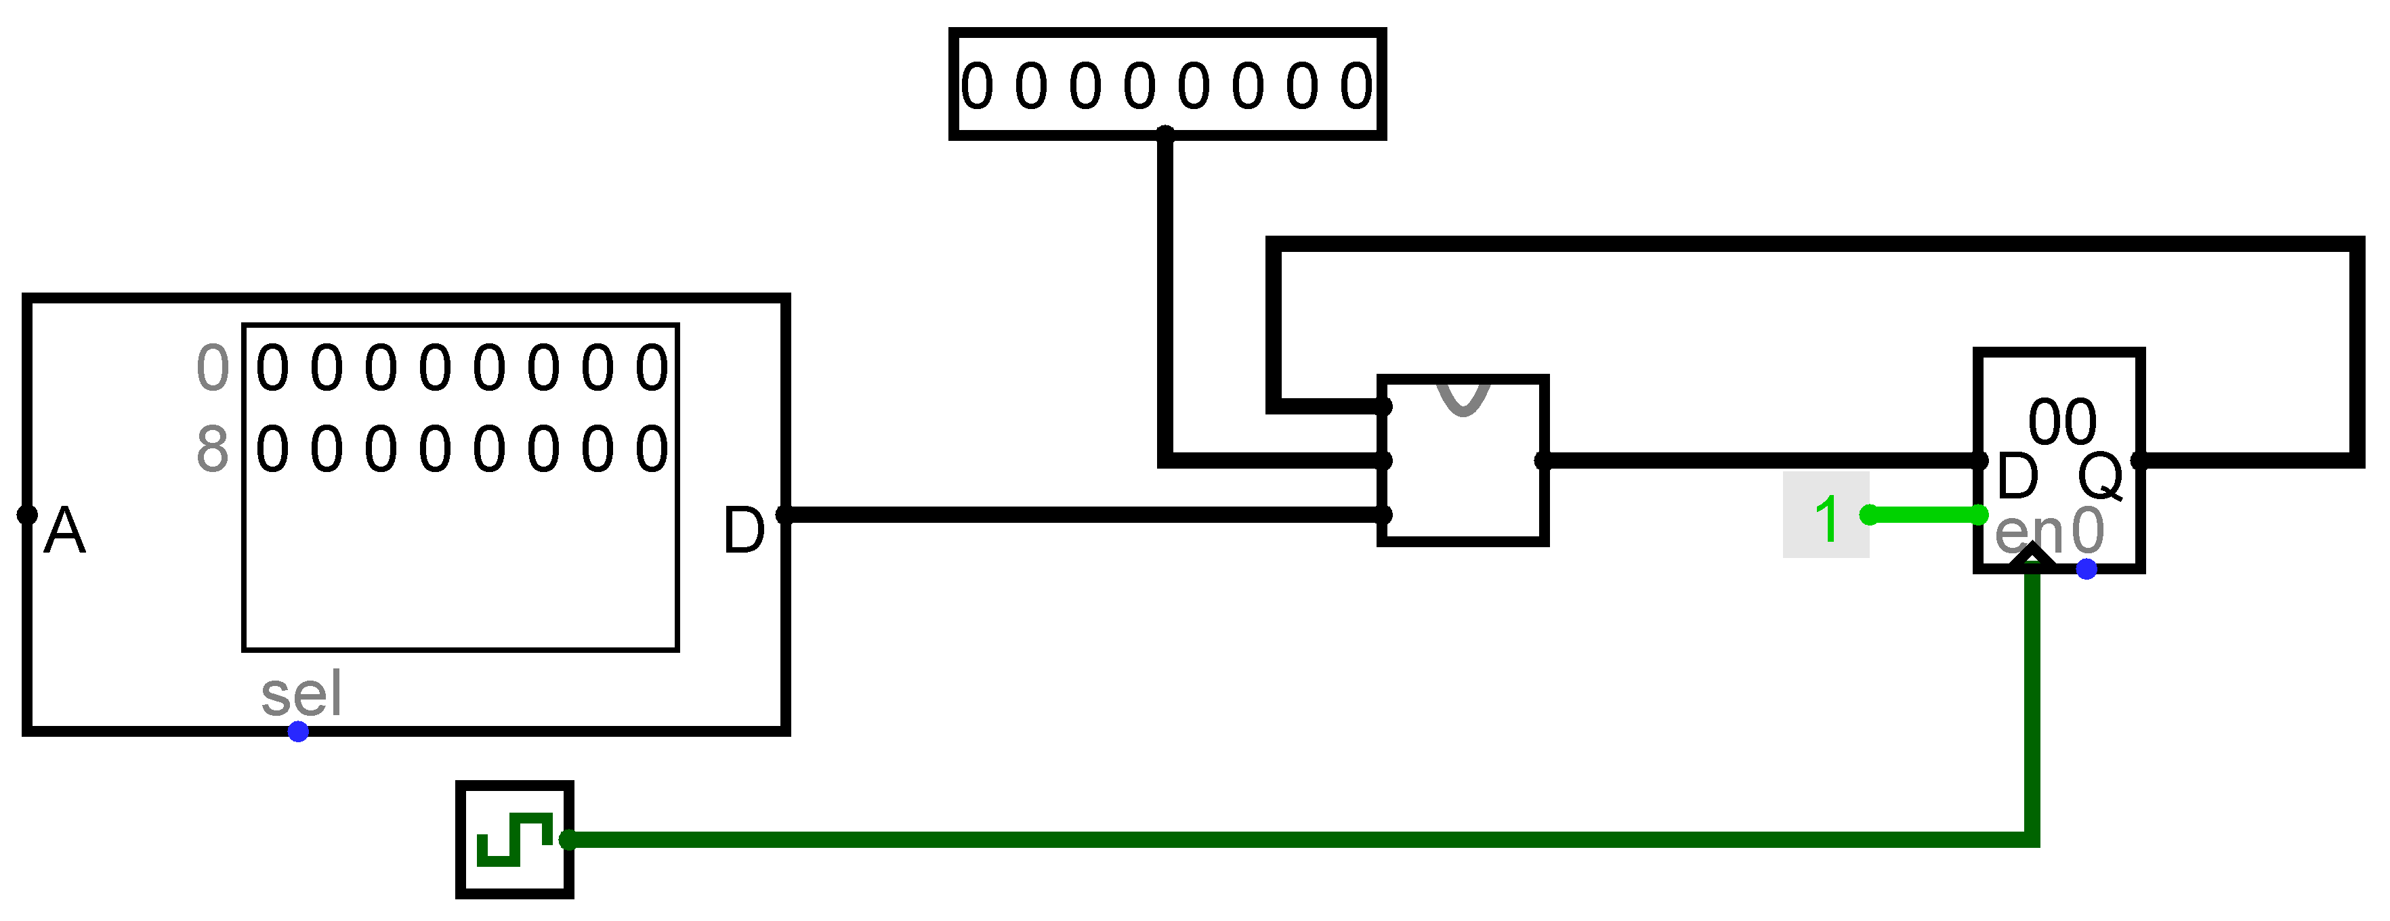
Feeding an instruction into the ALU
We can store instructions in order in a ROM

Slide 24
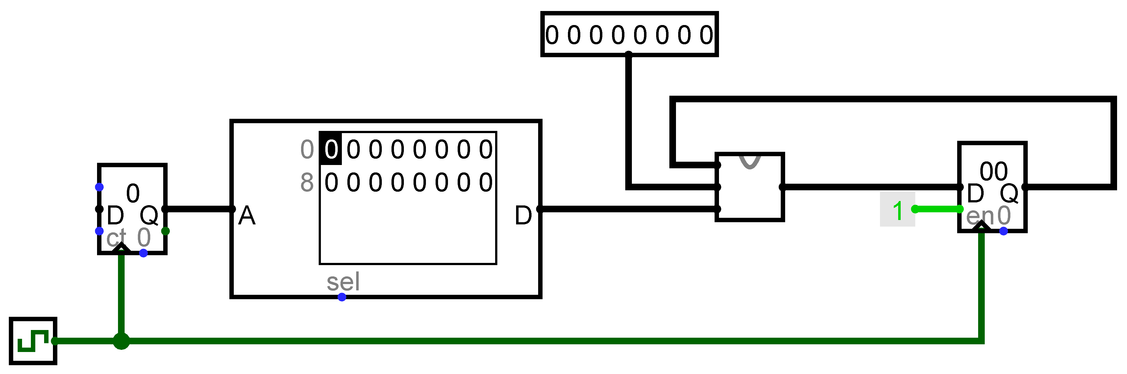
Stepping through the instructions
To run the program
Get an instruction from ROM and feed to operation of the ALU
Get next instruction
Use a counter

Slide 25
Planning a program
Suppose the program we want to run is
Add 12
Subtract 2
Multiply by 4
ALU OP value | Short format | Output
0 | ADD | The result of adding A and B together
1 | AND | The result of a bitwise A AND B
2 | SUB | The result of subtracting 1 from A
3 | LEFT | The result of shifting the bits in A left by one bit so that the rightmost bit will be filled with a zero.

Slide 26
Setting up a program
ALU OP value | Short format
0 | ADD
1 | AND
2 | SUB
3 | LEFT
Store our fixed number in the input pin – decimal 12
That is binary 00001100
I
nstruction
Operation
E
xpected
result
Expected result
(decimal)
(hex)
A
dd 12
0
12
c
S
ubtract
1
2
11
b
S
ubtract
1
2
10
a
Left shift
3
20
14
Left shift
3
40
28

Slide 27

Setting up the simulation
The second input and the program are set up
One instruction will run each time the clock goes to 1

Slide 28
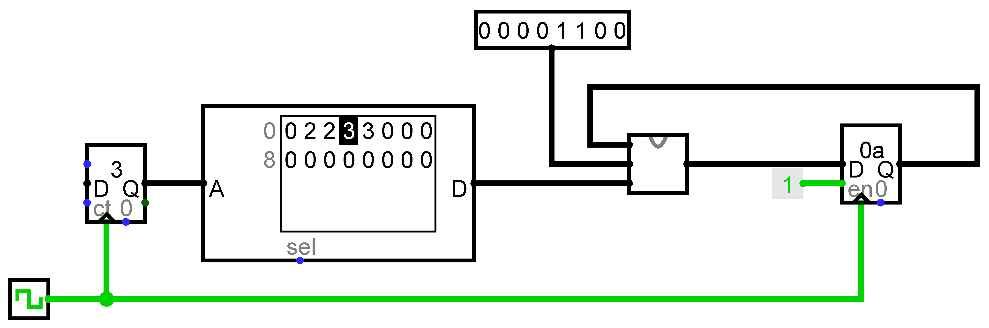

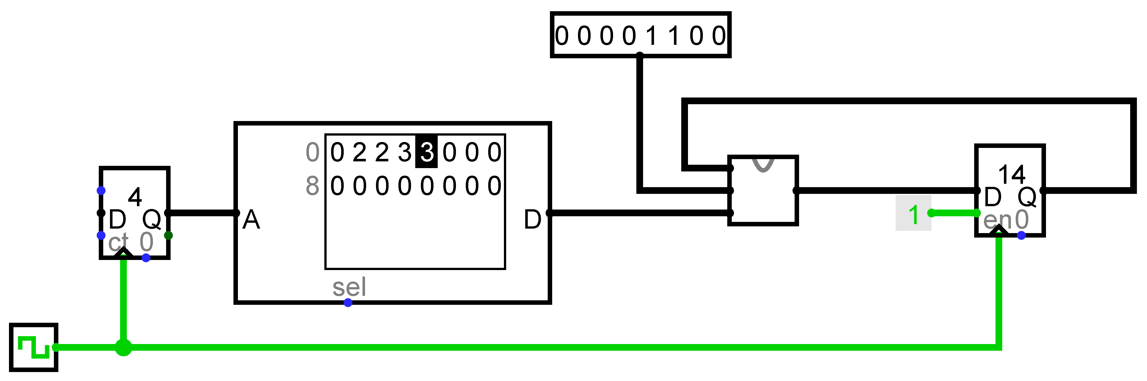
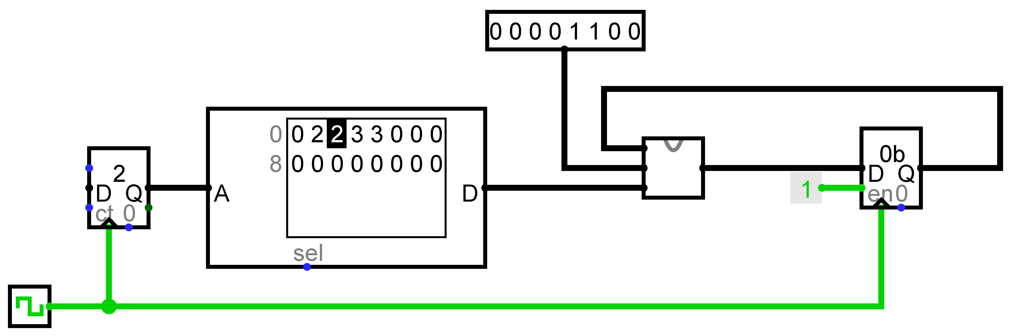

Running the program

Slide 29
Summary
We have looked at a counter and updating addressable memory
We have looked at how we could connect components together to create a device that can automatically carry out a list of instructions
You should build this automated device in the first part of your lab
There are instructions for a different program to plan and test
Remember that, even when we are using Logisim built-in components, we have built equivalents from basic logic gates
The complex behaviour of a running program is all built from simple parts.

